Slide 1


Slide 2

Employee Retention Prediction
“Focusing on employee retention prediction is essential for organizations aiming to minimize turnover and maintain a stable, skilled workforce. By leveraging machine learning techniques, businesses can identify key factors influencing job changes, such as employee satisfaction, work environment, career growth opportunities, and compensation. Predictive models help HR teams take proactive measures to retain top talent, reduce recruitment costs, and improve organizational performance. With data-driven insights, companies can personalize retention strategies, address employee concerns, and foster a more engaged and committed workforce”.

Slide 3
WORK FLOW
1.Introduction
2.Data Gathering/Data Refinement
3.Exploratary Data Analysis (EDA)
7.Conclusion
4.Feature Extraction
5.Methodology
6.Expremental Results
Importance of employee retention
Impact of job changes on business performance
Predict job change likelihood using employee data
Data Cleaning
Data Cleaning and Encoding categorical variables and Scaled numeric features
Understand employee characteristics and job change patterns
Identify key factors influencing job changes
Created new meaningful features from existing data
Applied one-hot encoding and label encoding , and feature scaling
Algorithm model used(logistic regression, random forest, XG Boost, Light GBM, ROC-AUC)
Applied SMOTE technique to balance classes
Evaluated model performance of test dataset
Identified the most accurate and robust model
Key findings and implications for employee retention strategies
.

Slide 4
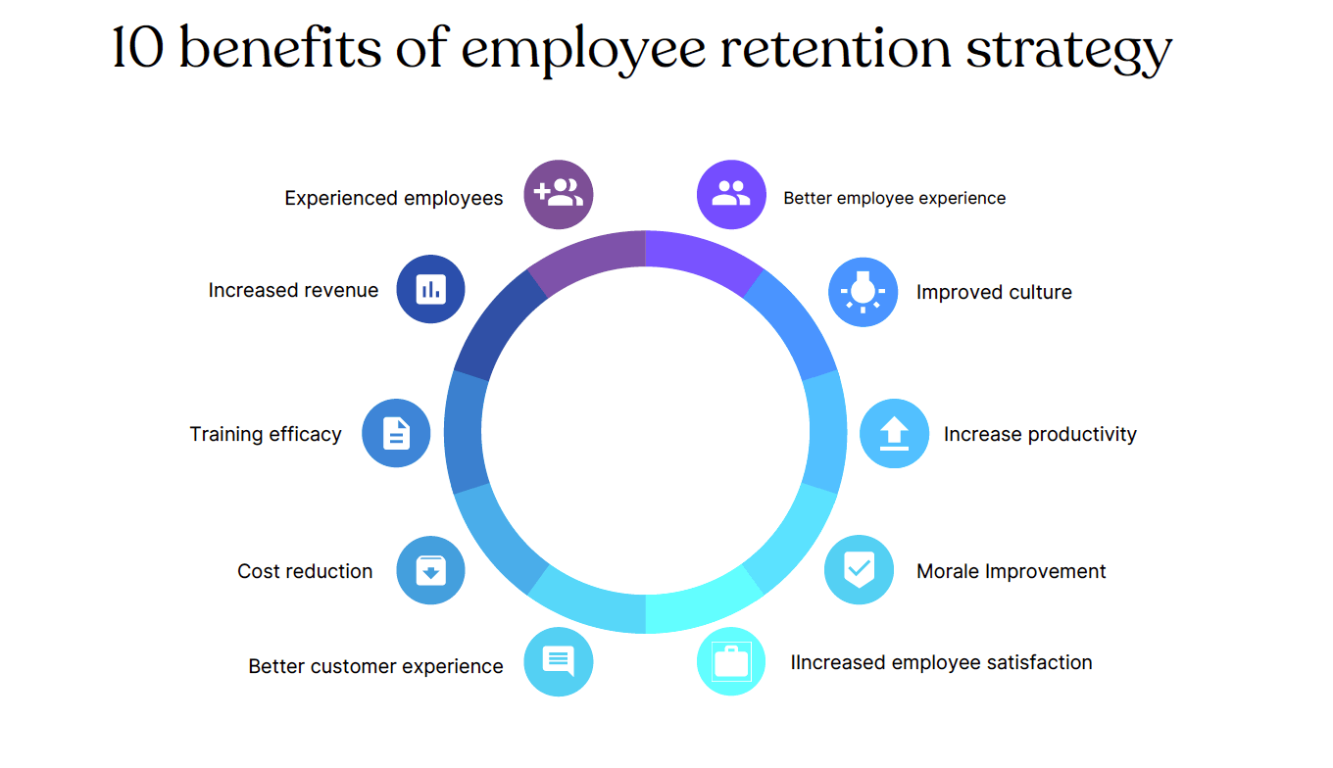
INTRODUCTION
Employee retention is important for companies because keeping good employees helps reduce hiring costs, maintain productivity, and improve workplace stability.
This dataset helps us understand why some employees stay while others look for new jobs, so companies can improve their retention strategies.
It includes details like experience, education, company size, training hours, and past job changes, which help predict whether an employee might leave.
The target column, "Looking for Job" tells us if an employee is searching for a new job (1) or staying in their current job (0).

Slide 5
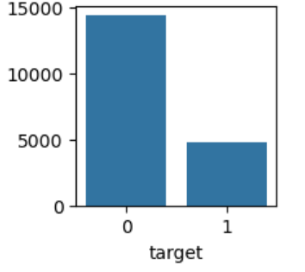
Data Overview
Data Description
Enrollee_id | Unique ID for Enroller
city | City code
City development index | Development index of the city (scaled)
gender | Gender of enrolee
Relevant experience | Relevant experience of enrolee
enrolled university | Type of University course enrolled if any
education level | Education level of enrolee
major discipline | Education major discipline of enrolee
experience | Enrolee total experience in years
company size | No of employees in current employer's company
company type | Type of current employer
Last new job | Difference in years between previous job and current job
training hours | training hours completed
target | 0 – Not looking for job change, 1 – Looking for a job change
Dataset | Rows | Column | Purpose
Train | 19158 | 14 | Model Training
Test | 2129 | 13 | Model Evaluation

Slide 6

EXPLORATARY DATA ANALYSIS
Exploratory Data Analysis (EDA) helped us understand the data structure, identify patterns, and extract key insights influencing employee retention.
We analyzed the distribution of each feature, checking for trends and correlations affecting employee job changes.
Data preprocessing involved handling missing values, encoding categorical variables (gender, company type, education level), and scaling numerical features (experience, training hours, city development index)
Class imbalance was addressed using SMOTE (Synthetic Minority Over-sampling Technique) to ensure a balanced dataset for better model performance.
Univariate and bivariate analysis revealed key trends:
Training Hours & Retention: Employees with more training hours tend to stay.
Experience & Retention: Mid-level experienced employees have a higher likelihood of switching jobs.
Company Type & Size: Larger organizations show lower attrition rates.
Visualizations, such as bar charts and correlation heat maps, helped in understanding feature relationships
Goal: Extracting meaningful insights to enhance employee retention strategies and predict job change likelihood.

Slide 7
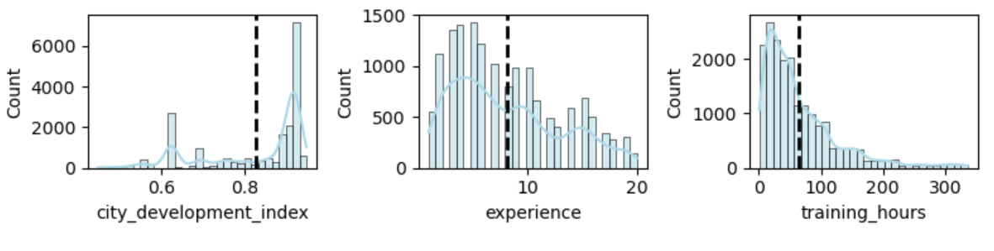
Exploring Key Numeric Trends
City Development Index: The distribution is right-skewed, with most values concentrated between 0.6 and 0.9. The mean (black dashed line) suggests that employees are generally from cities with high development indices.
Experience: The majority of employees have less than 15 years of experience, with a peak around 10 years. The distribution is slightly right-skewed, indicating that fewer employees have extensive experience beyond 20 years.
Training Hours: The distribution is highly right-skewed, with most employees completing less than 50 training hours. A small proportion of employees have significantly higher training hours, but they are outliers.

Slide 8
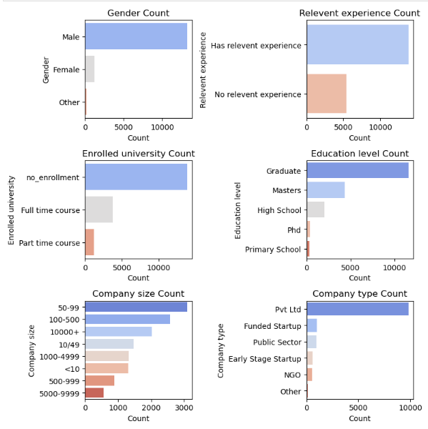
Categorical Feature Analysis
Gender Distribution:
The majority of employees are male, followed by female, with a small proportion categorized as other.
Relevant Experience:
A large number of employees have relevant experience, while a smaller segment has no relevant experience.
Enrolled University:
Most employees are not enrolled in any university.
Among those enrolled, full-time courses are more common than part-time courses.
Education Level:
The majority of employees hold a graduate degree, followed by master's degrees.
Very few employees have high school, PhD, or primary school education.
Company Size:
Most employees work in companies with 50-99 employees, followed by 100-500 and 10,000+ employees.
Fewer employees work in companies with less than 10 employees.
Company Type:
A significant number of employees work in Pvt Ltd companies.
Fewer employees are found in funded startups, public sector, NGOs, and early-stage startups.

Slide 9
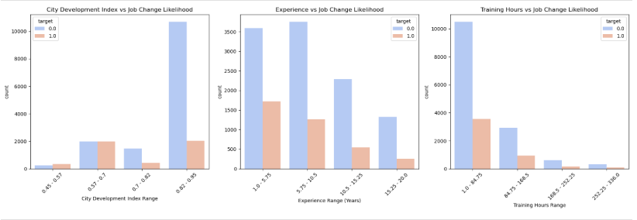
Impact of Numerical Factors on Job Change Likelihood
City Development Index vs Job Change Likelihood :
Employees from cities with a higher development index tend to stay in their current jobs (more blue bars for target = 0).
Those from lower development index cities show a higher tendency to switch jobs.
Experience vs Job Change Likelihood :
Employees with 1-5 years of experience have a higher probability of switching jobs (orange bars for target = 1 are noticeable in this range).
Those with 10+ years of experience tend to stay in their jobs.
Training Hours vs Job Change Likelihood :
Employees with fewer training hours (<50) are more likely to look for a new job.
As training hours increase, job retention improves, indicating that skill development may influence employees’ decisions to stay.

Slide 10
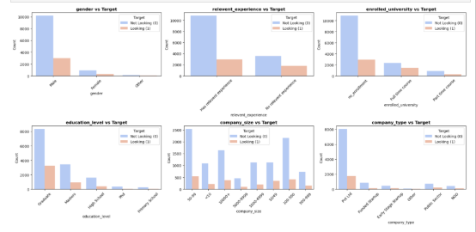
Impact of Categorical Factors on Job Change Likelihood
Gender vs. Target
Males (Male) have a higher proportion of job seekers compared to females.
Females (Female) show a lower proportion of job change likelihood.
Relevant Experience vs. Target
Candidates with prior experience tend to have a lower proportion of job changes.
Those with no relevant experience are more likely to switch jobs.
Enrolled University vs. Target
Individuals not enrolled in any university have a higher likelihood of job change.
Candidates enrolled in full-time courses show a lower proportion of job changes.
Education Level vs. Target
Candidates with higher education levels (Master's, PhD) exhibit a lower tendency to switch jobs.
Those with lower education levels (Bachelor’s, Diploma) show a higher proportion of job changes.
Company Size vs. Target
Employees in small-sized companies are more likely to seek job changes.
Large corporations show a lower proportion of job-switching behavior.
Company Type vs. Target
Employees in funded startups or early-stage companies exhibit higher job-switching tendencies.
Those working in public sector or multinational companies are less likely to switch jobs.

Slide 11

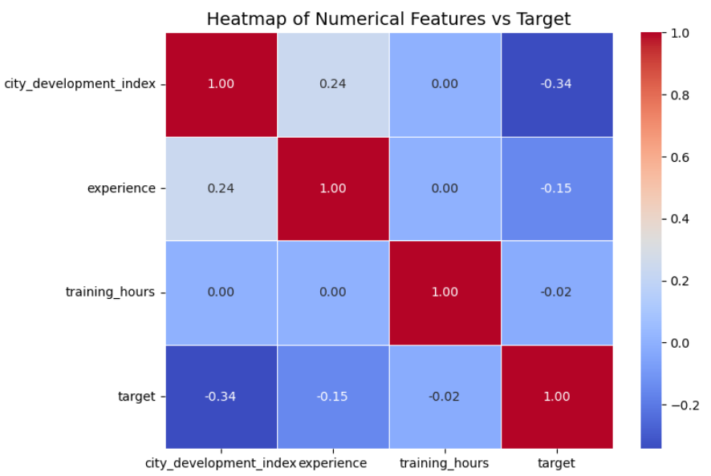
Correlation Analysis of Numerical Features with Target
City Development Index vs Target (-0.34)
A negative correlation of -0.34 suggests that employees from highly developed cities are less likely to look for a job change.
Experience vs Target (-0.15)
A weak negative correlation of -0.15 implies that employees with more experience are slightly less likely to switch jobs.
Training Hours vs Target (-0.02)
A near-zero correlation (-0.02) indicates that training hours have minimal impact on job change behavior.
Overall Interpretation:
City development index has the strongest negative correlation with job switching, meaning employees from well-developed areas are less likely to look for new jobs.
Experience has a weak negative relationship, indicating that more experienced employees tend to stay longer but not significantly.
Training hours show almost no effect on job retention.

Slide 12
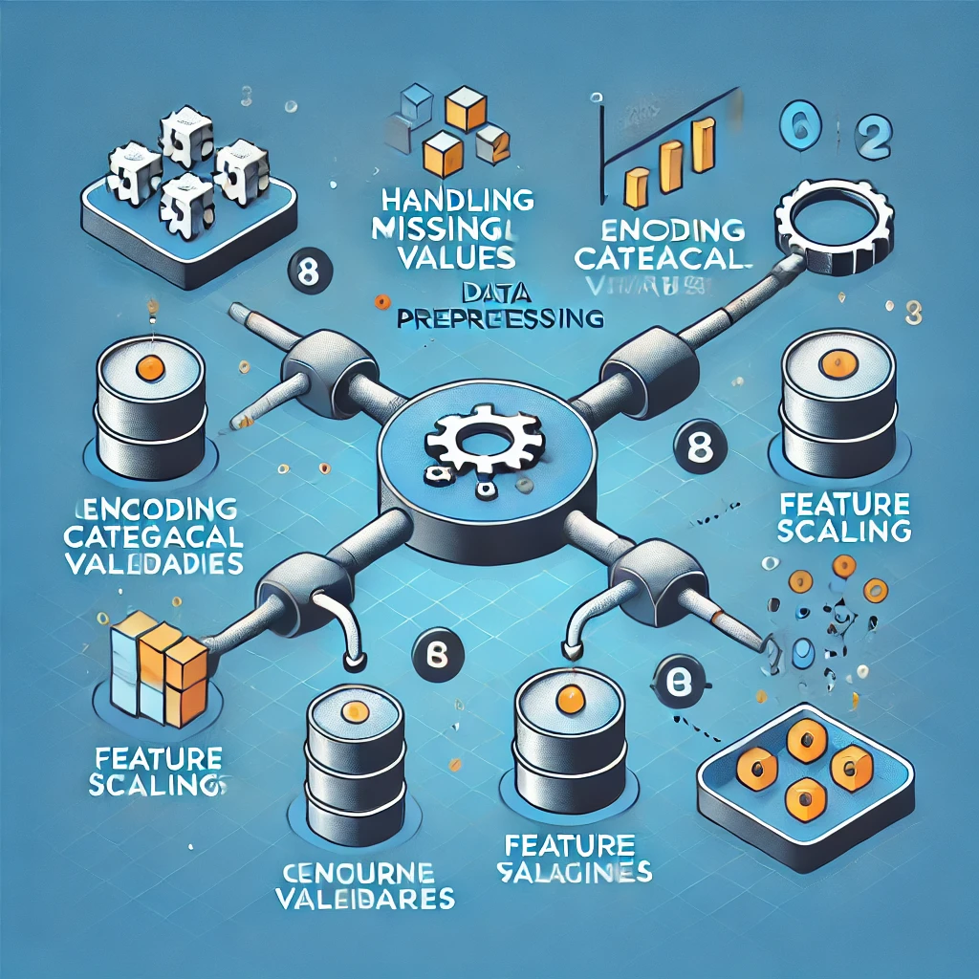
PREPROCESSING
Irrelevant Feature removal: I removed enrollee_id because it is just an ID and does not help in prediction. The city column was also dropped because it had too many unique values, which could add unnecessary complexity to the model.
Imputing Missing values: I filed missing values in categorical columns with most common value(mode) and used the median for numerical columns to keep the data balanced.
Handling Class imbalance Data: since target variable was imbalanced we use SMOTE(Synthetic Minority Over-Sampling Technique.
Feature Encoding for Model Training: to make the data suitable for the model we applied encoding for both numeric and categorical features. It ensures that all features are in the format the model can understand, improving its ability to learn patterns effectively.
Feature scaling: I standardize numerical features like Logistic Regression, XGBoost, LightGBM, Which perform better when data is on similar scale.

Slide 13
Training and Validation split:
I divide the training data into two parts 80% for training and 20% for validation to fine tune the model before testing.
We used random state to get consistence results, and stratification to keep target variable’s distribution the same in both sets.
SPLITING DATASET INTO X AND Y :
We divide resample dataset into two parts X_train, X_val and y_train,y_val.
X_train, X_val: independent features.
y_train, y_val : target variables.

Slide 14
MODEL SELECTION :
Logistic Regression: Logistic Regression is commonly used for binary classification problems. It is preferred because it provides a simple and efficient way to model the relationship between independent variables and the probability of an employee leaving or staying.
Random Forest: Random Forest is an ensemble learning method that combines multiple decision trees to improve accuracy and reduce overfitting. It is effective for handling missing values, capturing feature importance, and making robust predictions.
XGBoost: Extreme Gradient Boosting (XGBoost) is a powerful boosting algorithm known for its speed and performance. It works well with structured data, handles imbalanced datasets efficiently, and is optimized for high predictive accuracy.
LightGBM: LightGBM is a gradient boosting framework that is faster and more memory-efficient than traditional boosting models. It handles large datasets effectively and is particularly useful for dealing with categorical features and imbalanced classes.

Slide 15
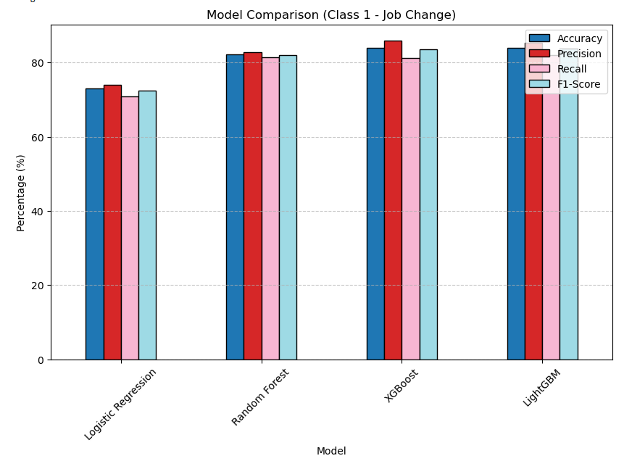
MODEL COMPARISION
Models | Accuracy(%) | Precision(%) | Recall(%) | F1-score(%)
Logistic Regression | 72.57 | 73.99 | 70.82 | 72.37
Random Forest | 82.21 | 82.77 | 81.39 | 82.08
XGBoost | 83.7 | 85.97 | 81.18 | 83.51
LightGBM | 84.33 | 85.35 | 82.093 | 83.69
Accuracy: Measures the overall correctness of the model.
Precision: Measures how many of the predicted positives are actually positive.
Recall: Measures how many actual positives were correctly predicted.
F1-Score: The harmonic mean of precision and recall, balancing both metrics.

Slide 16
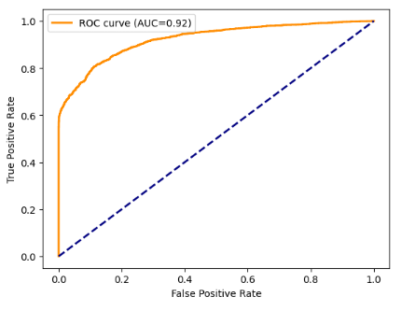
ROC-AUC CURVE for LightGBM
The employee retention prediction model demonstrates strong predictive capability, as evidenced by an AUC score of 0.92. This high AUC value suggests that the model effectively distinguishes between employees likely to leave and those who will stay.
Key takeaways:
High Predictive Power: The model's high AUC indicates strong classification performance.

Slide 17
EXPERIMENTAL RESULT
Best Performing Model:
LightGBM achieved the highest accuracy (84.33%) and highest F1-score (83.69%), making it the most effective model for predicting employee retention.
XGBoost performed closely with LightGBM, showing high precision (85.97%) and a strong recall (81.18%), making it an effective alternative.
Random Forest Performance With an accuracy of 82.21%, Random Forest performed well but lagged slightly behind boosting models in terms of recall and F1-score.
Logistic Regression had the lowest accuracy (72.57%) and F1-score (72.37%), indicating that it may not capture complex patterns as well as tree-based models.
Conclusion:
Boosting models (LightGBM and XGBoost) are the best choices for employee retention prediction due to their superior predictive capabilities.
.

Slide 18
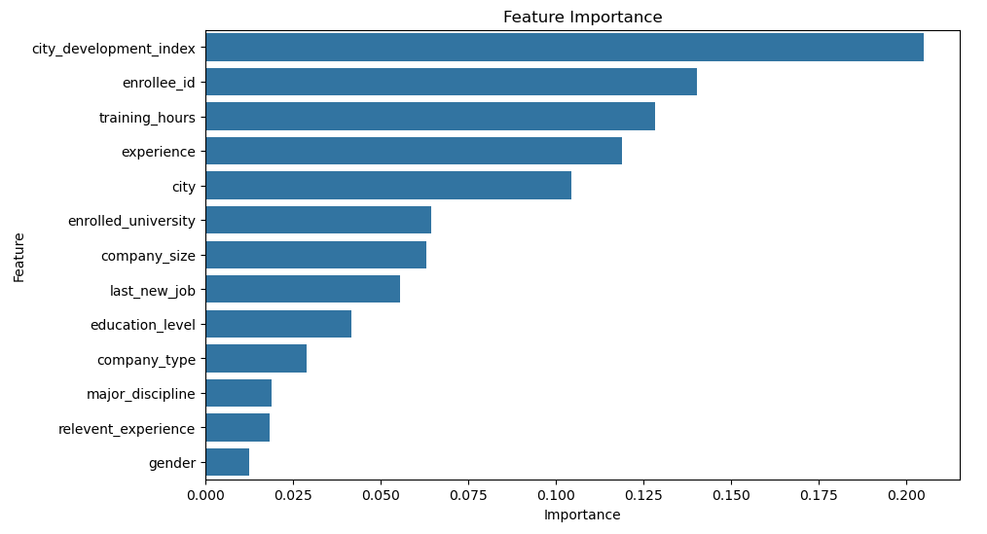
FEATURE IMPORTANCE
City Development Index is the most influential factor in predicting employee retention, indicating that economic conditions and urban development play a significant role.
Enrollee ID and Training Hours also contribute heavily, suggesting that individual-level characteristics and professional development impact retention.
Experience and City follow closely, reinforcing the idea that prior work history and location affect an employee's likelihood to stay or leave.
Enrolled University, Company Size, and Last New Job hold moderate importance, implying that educational background and company-related factors influence retention.
Gender, Relevant Experience, and Major Discipline are among the least important features, indicating that these attributes may have a lower direct impact on predicting employee retention.

Slide 19
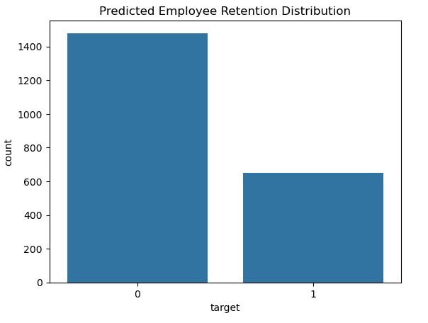
PREDICTION
After evaluation, LightGBM (lgbm_model) was identified as the best-performing model for employee retention prediction, achieving the highest accuracy and F1-score.
Prediction:
The trained LightGBM model was applied to the scaled test dataset (X_test_scaled) to generate predictions.
The predicted retention status (target) represents the likelihood of an employee seeking a job change.
Submission File Generation:
A submission file, employee_retention_prediction.csv, was created.
It contains training hours from the test dataset alongside the corresponding predicted retention status for employees.
This structured output ensures clarity and usability for HR decision-making.
The LightGBM model provides a robust and highly accurate prediction of employee retention trends, enabling organizations to make data-driven talent management decisions and optimize employee engagement strategies.
The majority class (0) represents employees who are not looking for a job change, with approximately 1,775 instances.
The minority class (1) represents employees who are looking for a job change, with approximately 354 instances.

Slide 20
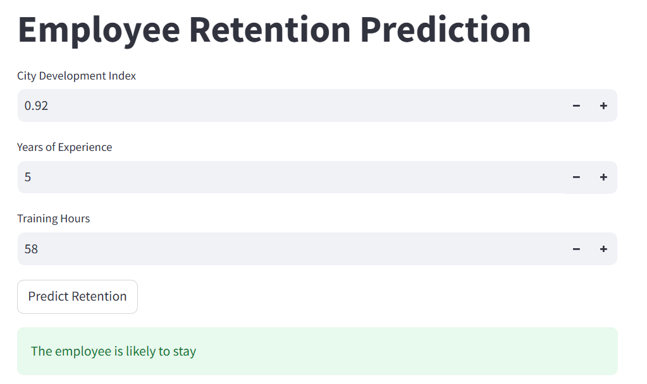
MODEL DEPLOYEMENT (Streamlit App)

Slide 21
CONCLUSION
In this project, we successfully developed a machine learning model to predict employee retention using the ‘aug_train.csv ‘dataset. The model helps organizations identify employees likely to leave, enabling better workforce planning and retention strategies.
Key Findings:
Feature Importance:
The most influential factors are city_development_index, training_hours, experience, and company size.
Gender and relevant experience had the least impact.
Model Performance:
Tested Logistic Regression, Random Forest, XGBoost, and LightGBM.
LightGBM performed the best in accuracy and efficiency.
Challenges and Solutions:
Imbalanced Data: Resolved using SMOTE.
Missing Values: Imputed missing values.
Categorical Encoding: Applied label Encoding.
Predictions on `aug_test.csv`: - Since `aug_test.csv` lacks the target variable, we saved predictions in `employee_retention_predictions.csv`.

Slide 22
THANK YOU

